Slide 1
Data Compression for comet interceptor

Slide 2
Project Overview
Magnetometer data will be provided as 14 bit signed integers
Create algorithms to achieve the highest possible compression ratio
Compression technique must be lossless
Optimise highest compression ratio versus lowest latency
Account for low processing capability due to hardware limitations

Slide 3
Difference encoding
Initial Value Difference
Previous Value Difference
1200
1200-1200
0
1200
1200-1200
0
1205
1205-1200
5
1205
1205-1200
5
1210
1210-1200
10
1210
1210-1205
5
1190
1190-1200
-10
1190
1190-1210
-20
1203
1203-1200
3
1203
1203-1190
13

Slide 4
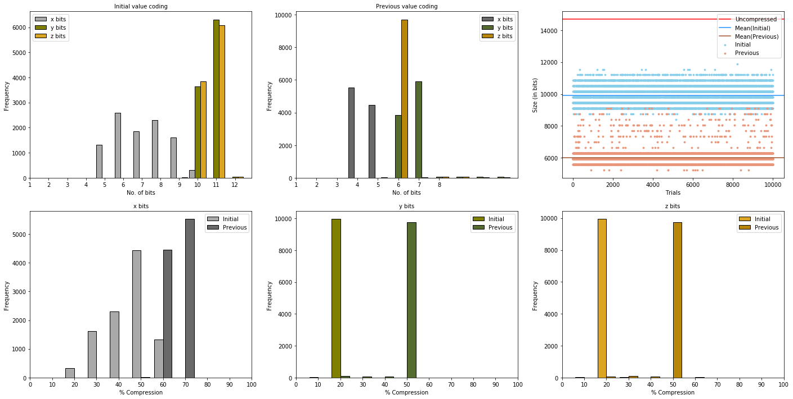
Difference ENCoding

Slide 5
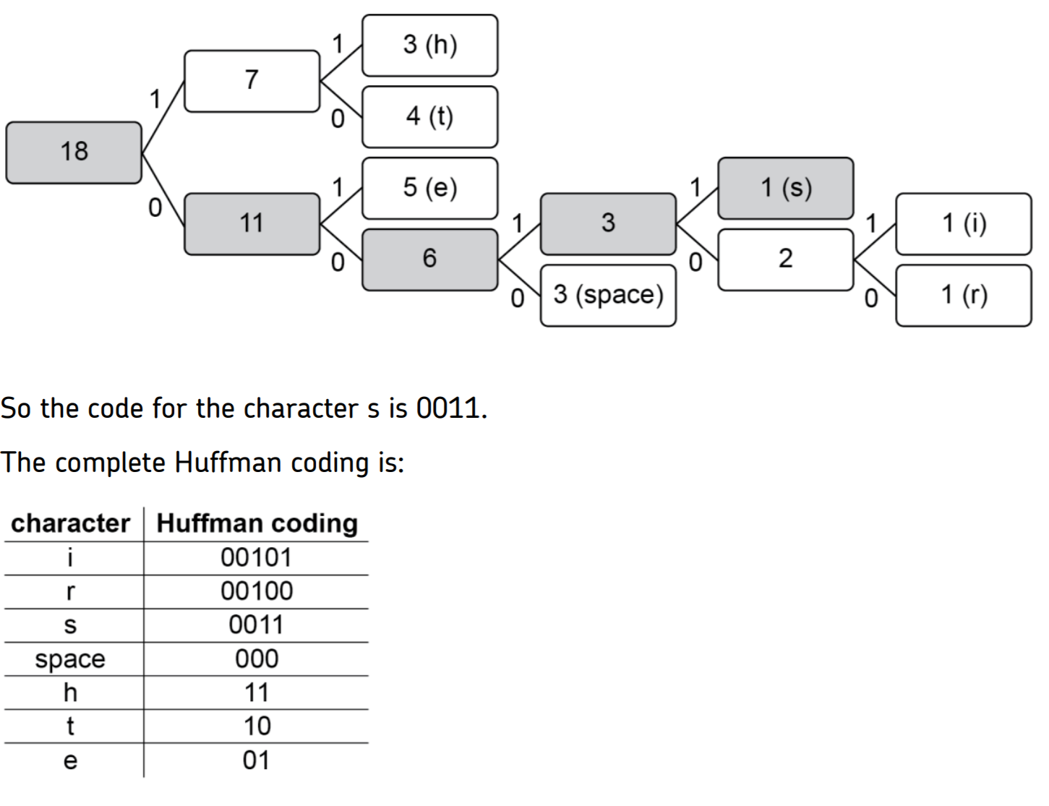
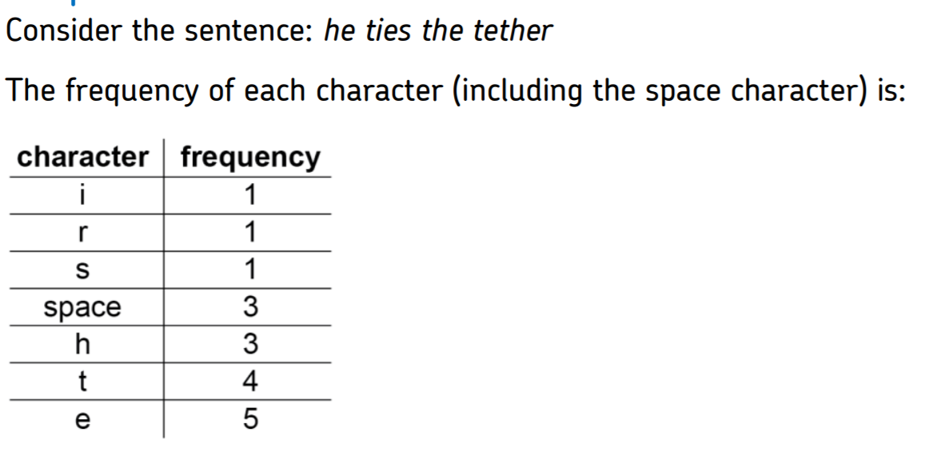
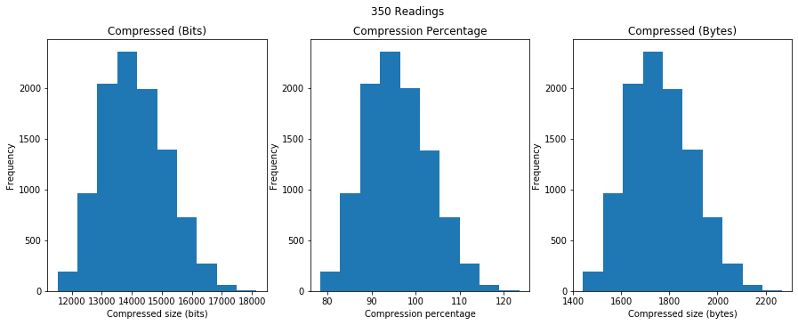
Huffman encoding

Slide 6
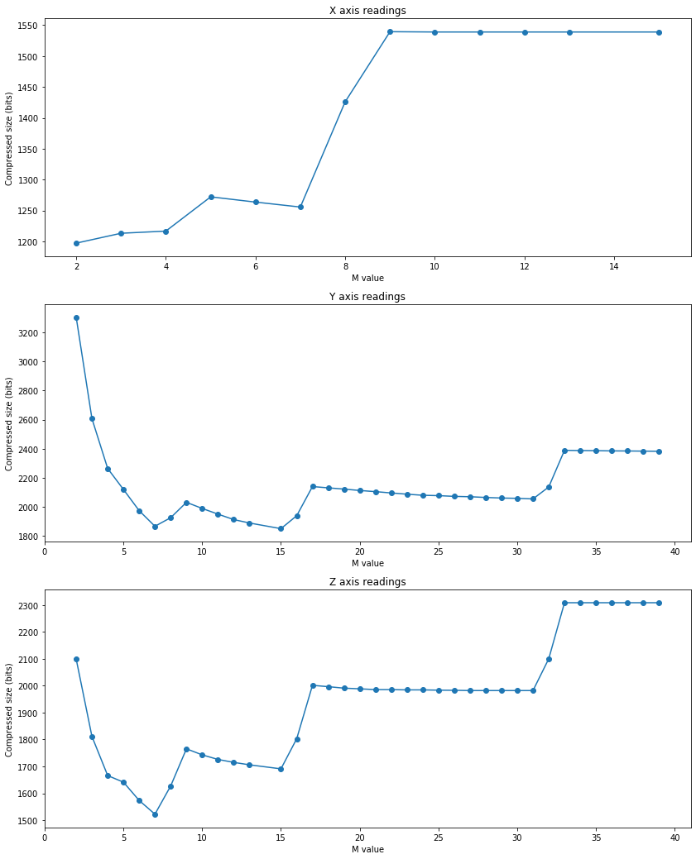
Golomb encoding
b=ceil(log₂M)
r=N-qM
If r<2^{b}-M
b-1 bits for r
N
Else
b bits for r+2^{b}-M
q=floor(N/M)
Unary code
Full Binary Form
Optimal M value inconsistent across axes
Provides compression ratio of 31%
M=5
b=3
r=4
If r<3
2 bits
14
Else
3 bits for 4+3 (111)
q=2
110
110111

Slide 7
Review and further work
Golomb coding with difference recursion provides the best compression ratio of 31%
Is there a perfect sample size for lowest latency and best compression ratio?
Can we dynamically allocate an M value for Golomb coding?
How can we change sample size dynamically to account for periods of inactivity?

Slide 8
Thank you for your attention
Any Questions?

Slide 9
N (M=3) | Floor Value | Unary | Remainder | Binary | Combined
0 | 0 | 0 | 0 | 0 | 00
1 | 0 | 0 | 1 | 01 | 001
2 | 0 | 0 | 2 | 10 | 010
3 | 1 | 10 | 0 | 0 | 100
4 | 1 | 10 | 1 | 01 | 1001
5 | 1 | 10 | 2 | 10 | 1010
6 | 2 | 110 | 0 | 0 | 1100
7 | 2 | 110 | 1 | 01 | 11001
8 | 2 | 110 | 2 | 10 | 11010
9 | 3 | 1110 | 0 | 0 | 11100
10 | 3 | 1110 | 1 | 01 | 111001
M=5
b=3
r=4
If r<3
2 bits
14
Else
3 bits for 4+3 (111)
q=2
110
110111
b=ceil(log₂M)
r=N-qM
If r<2^{b}-M
b-1 bits for r
N
Else
b bits for r+2^{b}-M
q=floor(N/M)
Unary code
Full Binary Form
1200
1200-1200
0
1200
1200-1200
0
1205
1205-1200
5
1205
1205-1200
5
1210
1210-1200
10
1210
1210-1205
5
1190
1190-1200
-10
1190
1190-1210
-20
1203
1203-1200
3
1203
1203-1190
13

Slide 10
N
b=ceil(log₂M)
N=14
M=5
b=3
q=floor(N/M)
r=N-qM
q=2
r=4
If r<2^{b}-M
b-1 bits for r
110
If r<3
2 bits
Unary code
Else
Else
3 bits for 4+3 (111)
b bits for r+2^{b}-M
110111
Full Binary Form

